Slide 1



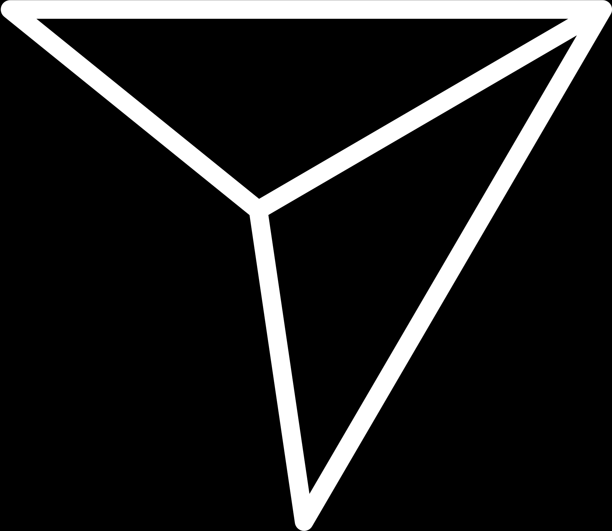
trainity
INSTAGRAM USER ANALYTICS
SALMAN BAREESH

Slide 2
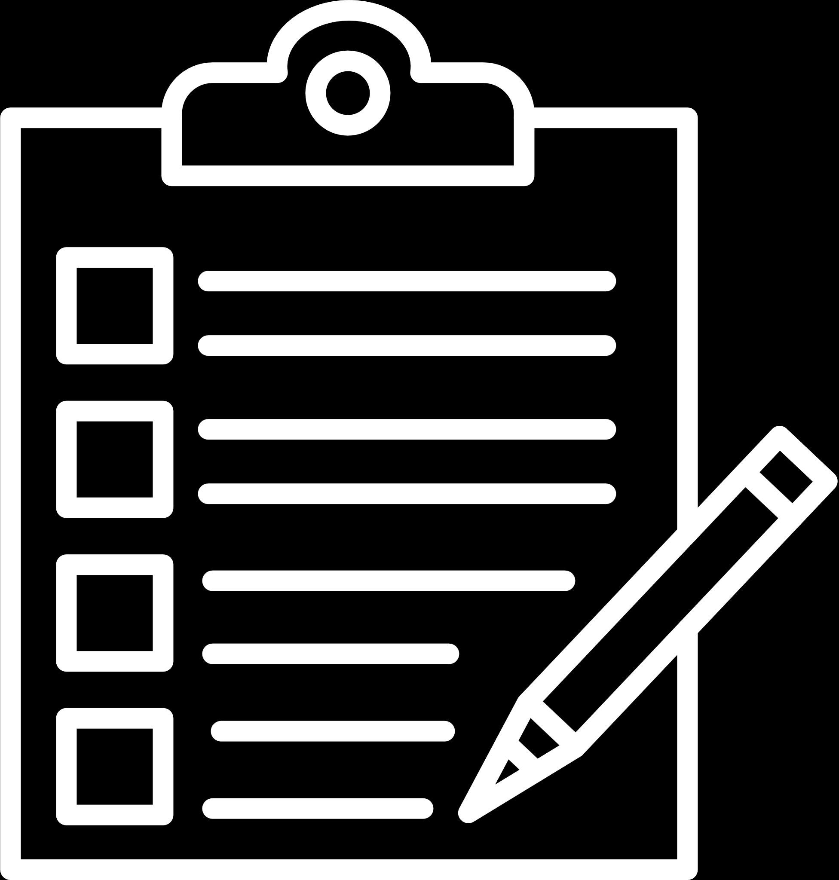

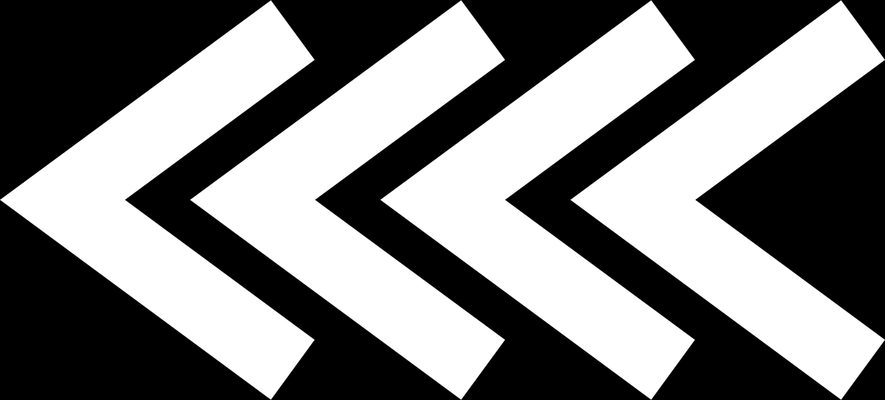
PROJECT DESCRIPTION
The given Project requires a user analysis of Instagram users where insights are required for the Marketing Team with respect to Most Loyal Users ; Inactive Users ; Most liked picture ; Hashtag researching and for Launching an AD Campaign.
Insights are also required on User Engagement and on Bots and Fake Accounts for the Investors.
The above information will be extracted from the given database with the help of SQL queries

Slide 3
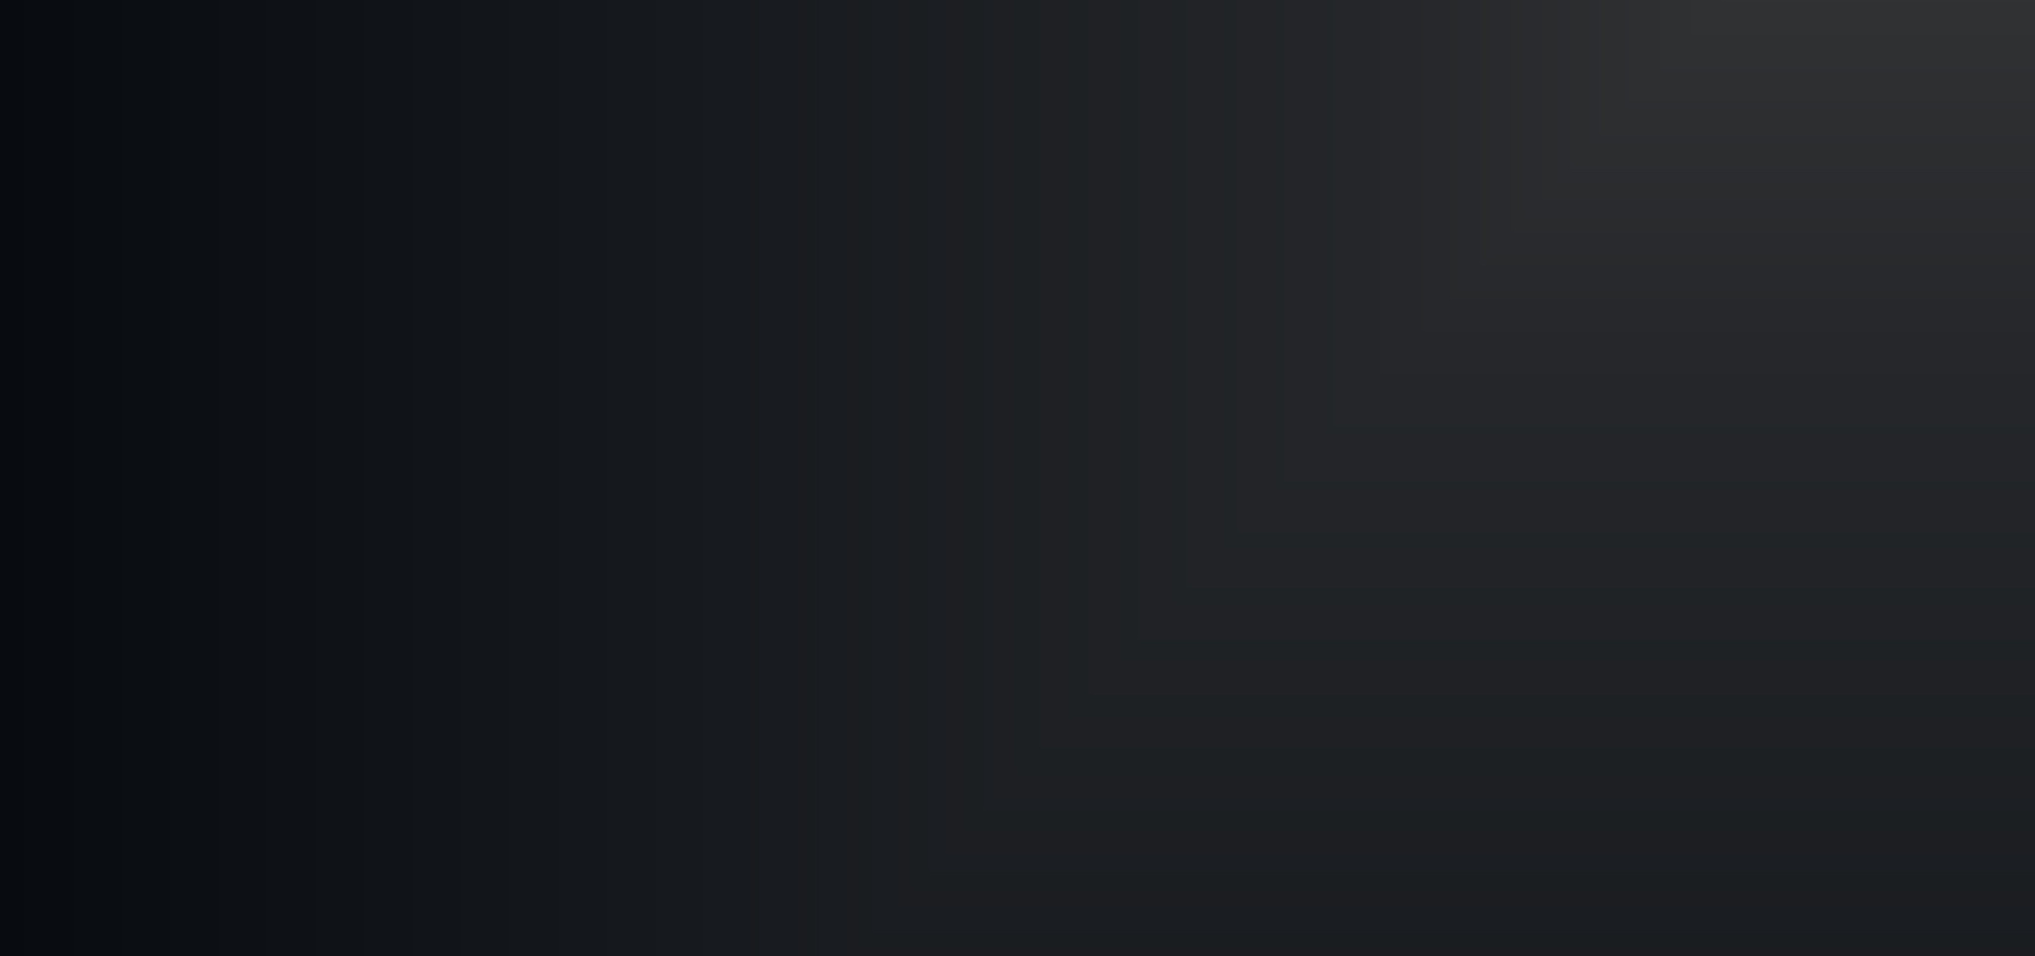
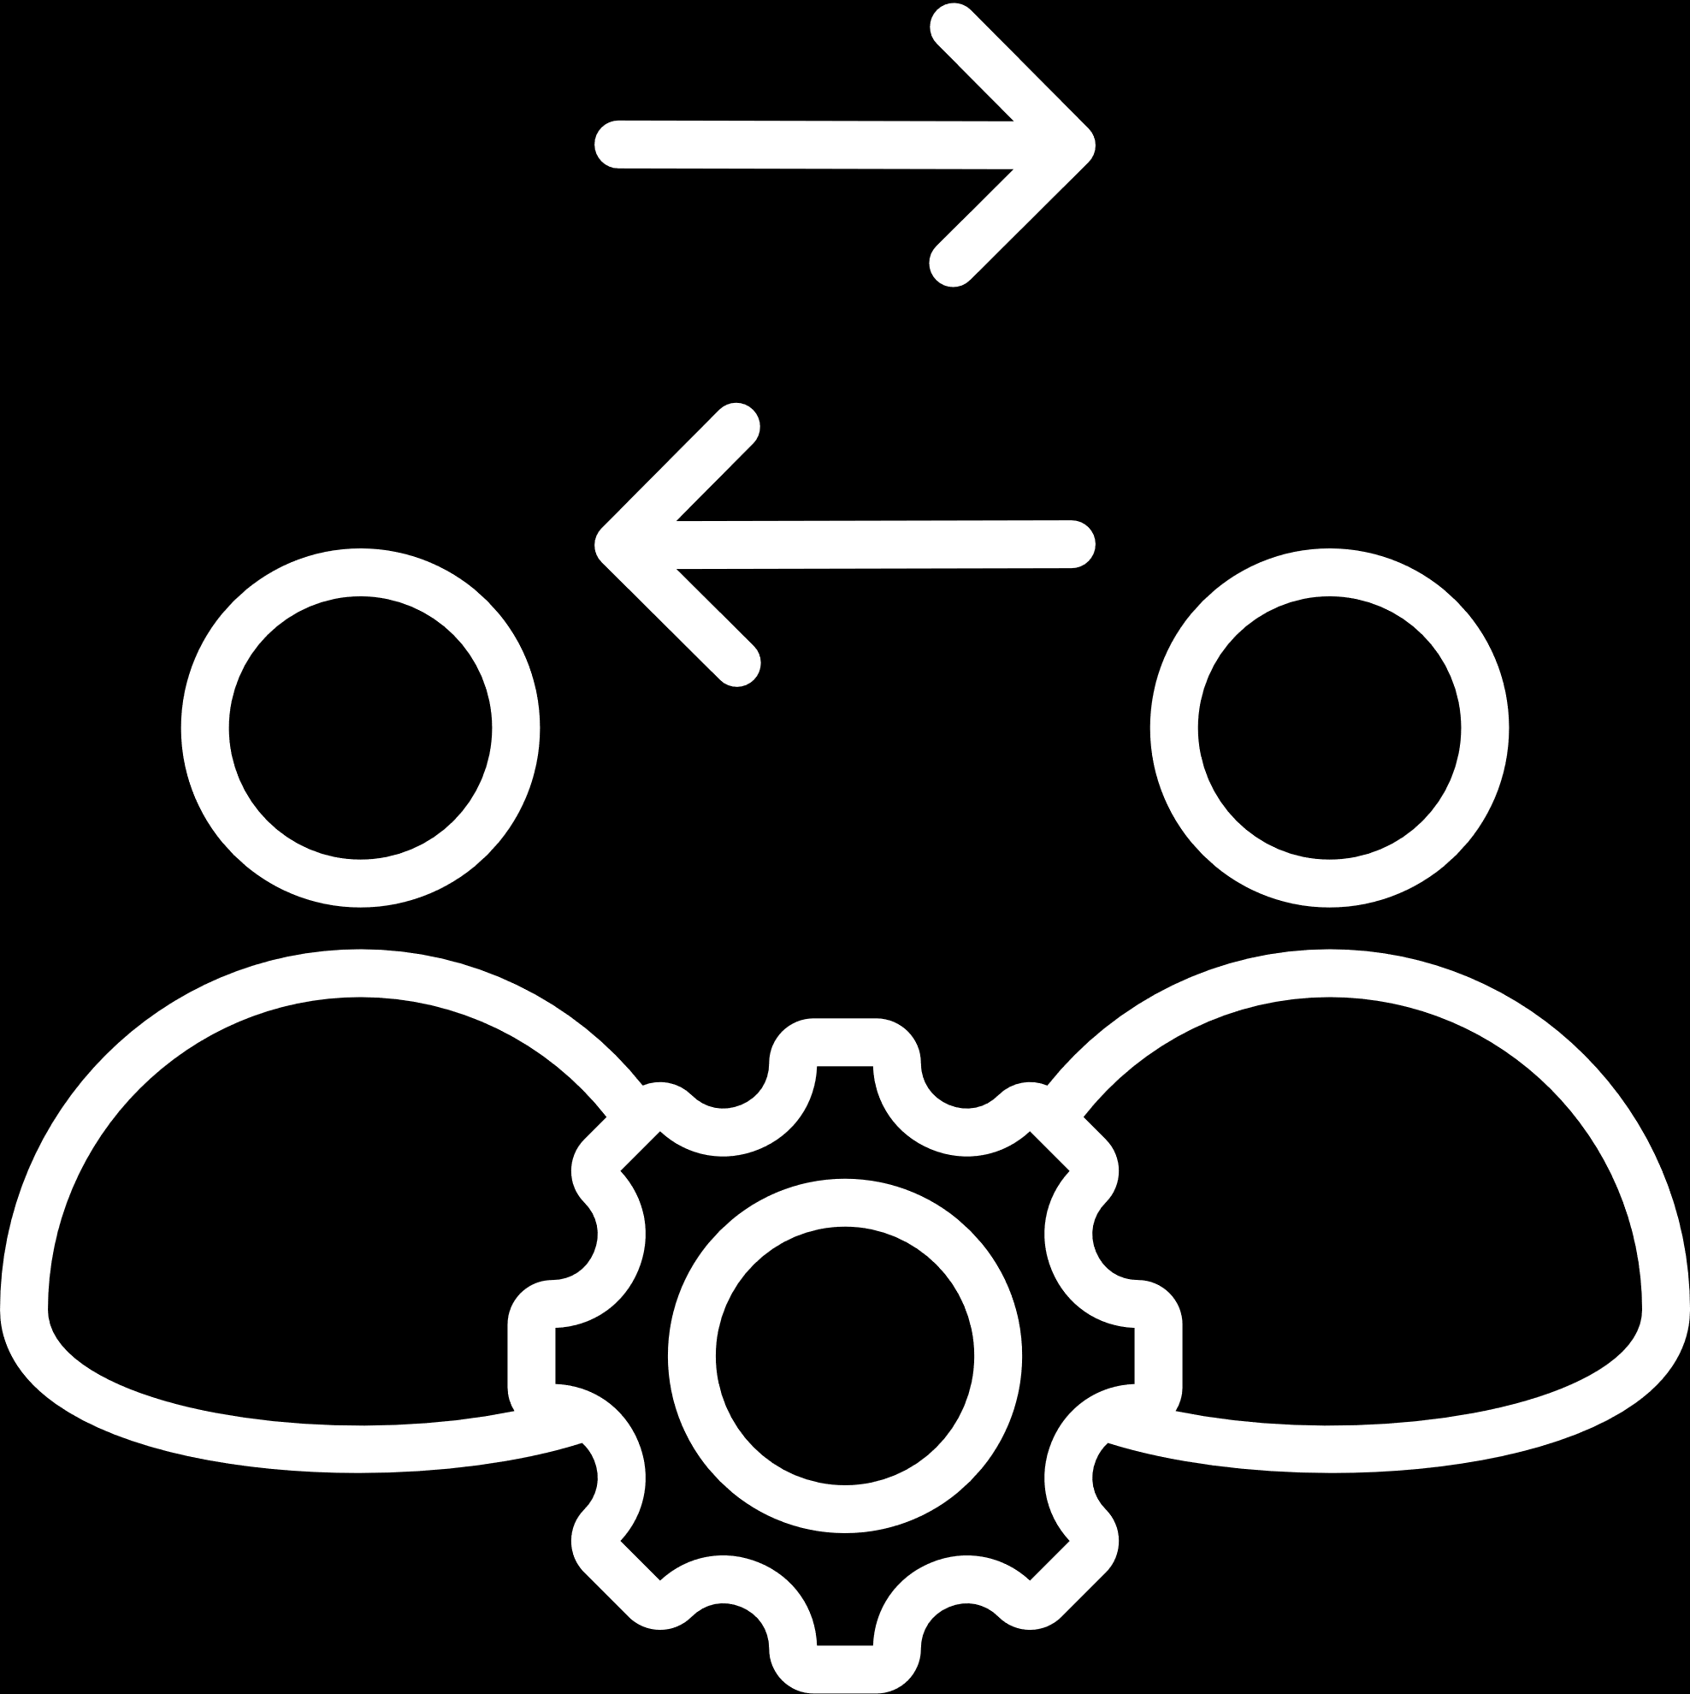
APPROACH
An approach of extracting entire required information from the given database using SQL queries was adopted.
This approach was executed using MySQL software.
Above approach resulted in direct insights on the questions asked without discomfort.

Slide 4
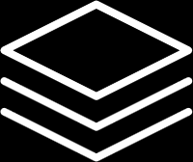
TECH-STACK USED
MySQL was used to run SQL queries
The reason I chose this language is because I have prior experience from my college

Slide 5
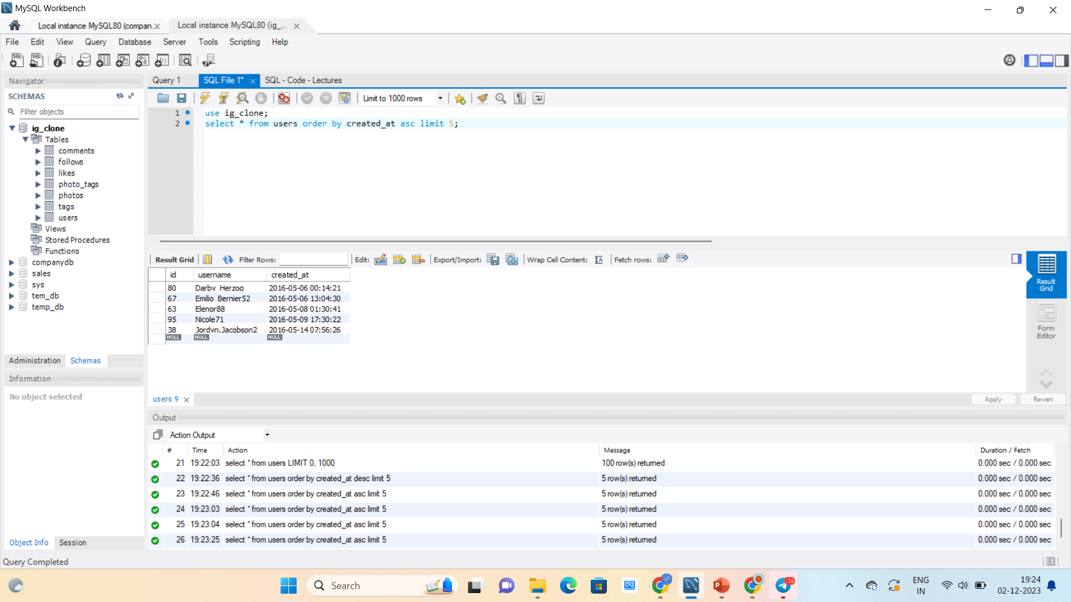
MARKETING ANALYSIS INSIGHTS
1. Loyal User Reward
The following are the five oldest users on Instagram from the provided database.
Syntax
select * from users
order by created_at asc limit 5;

Slide 6
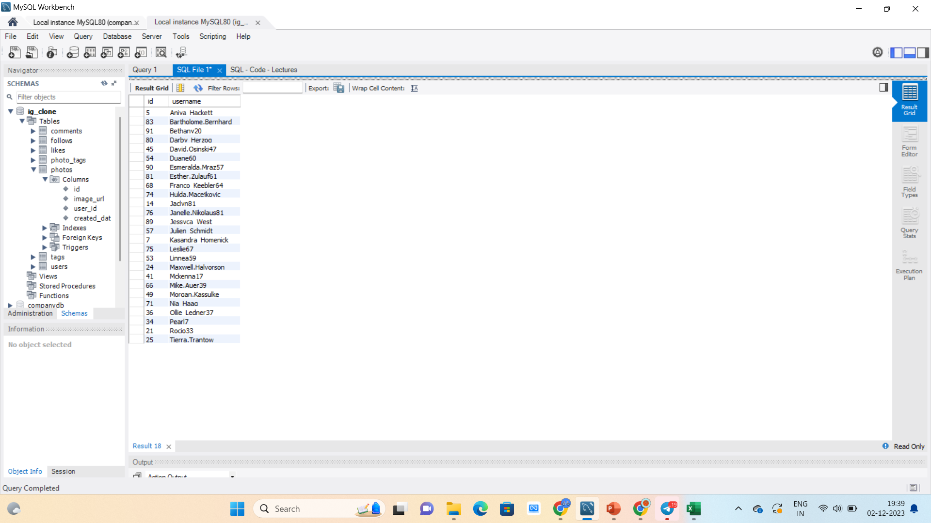
MARKETING ANALYSIS INSIGHTS
2. Inactive User Engagement
The following are the users,totaly 26 accounts who have not posted a single photo on Instagram
Syntax
select users.id,username from users
left join photos on users.id = photos.user_id
where photos.id is NULL order by username asc;

Slide 7
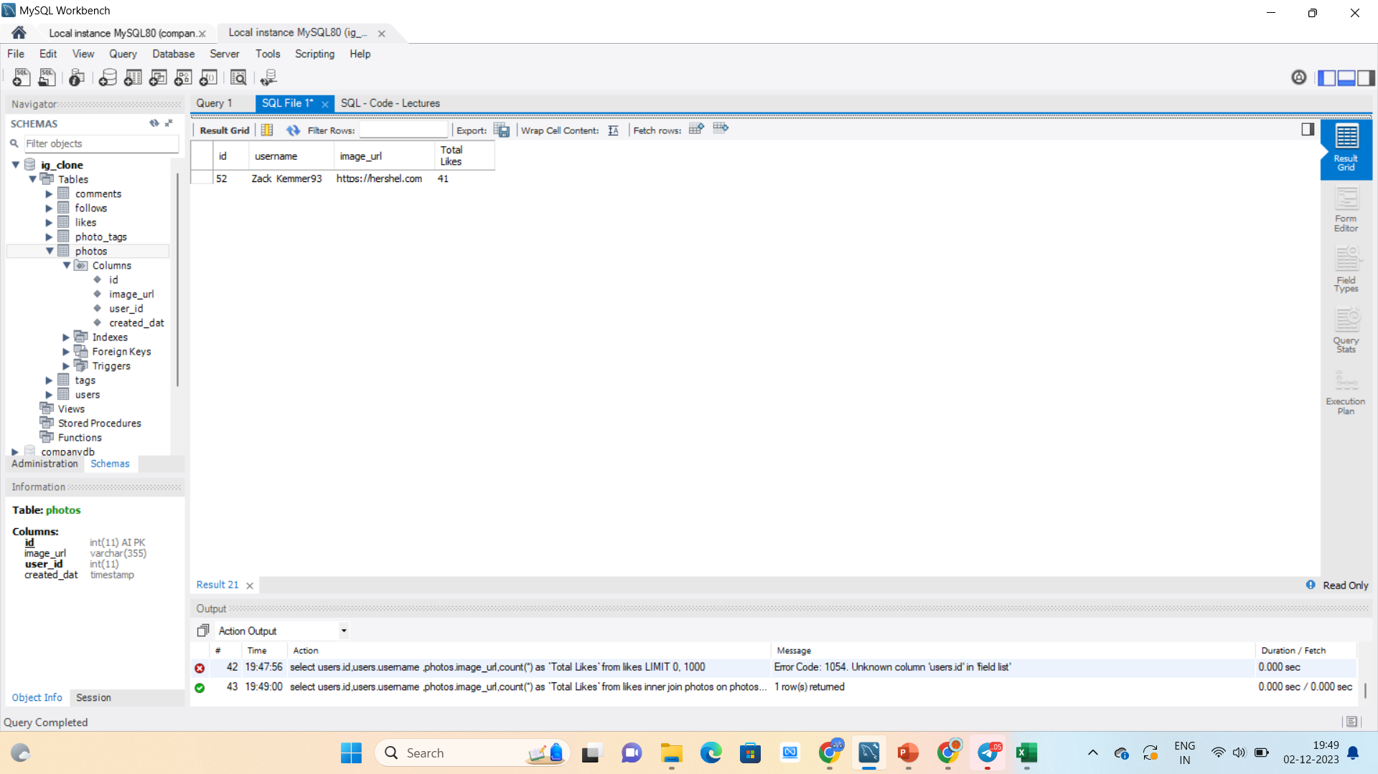
MARKETING ANALYSIS INSIGHTS
3. Contest Winner Declaration
The Zack Kemmer93 have got more likes and we can determine the winner of the contest
Syntax
select users.id,users.username ,photos.image_url,count(*) as `Total Likes` from likes
inner join photos on photos.id = likes.photo_id
inner join users on users.id = likes.photo_id
group by photos.id
order by `Total Likes` desc limit 1;

Slide 8
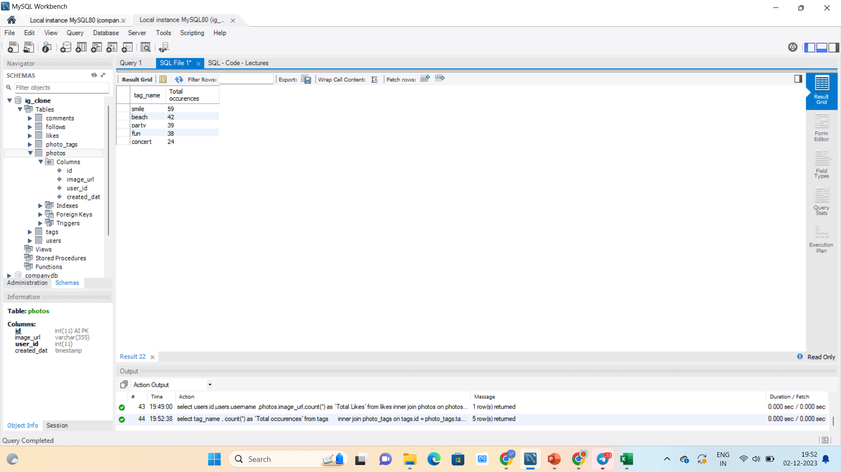
MARKETING ANALYSIS INSIGHTS
4. Hashtag Research
The following are the most used tags which can be used by the Partner brand to increase their reach
Syntax
select tag_name , count(*) as `Total occurences` from tags
inner join photo_tags on tags.id = photo_tags.tag_id
group by tags.id
order by `Total occurences` desc limit 5;

Slide 9
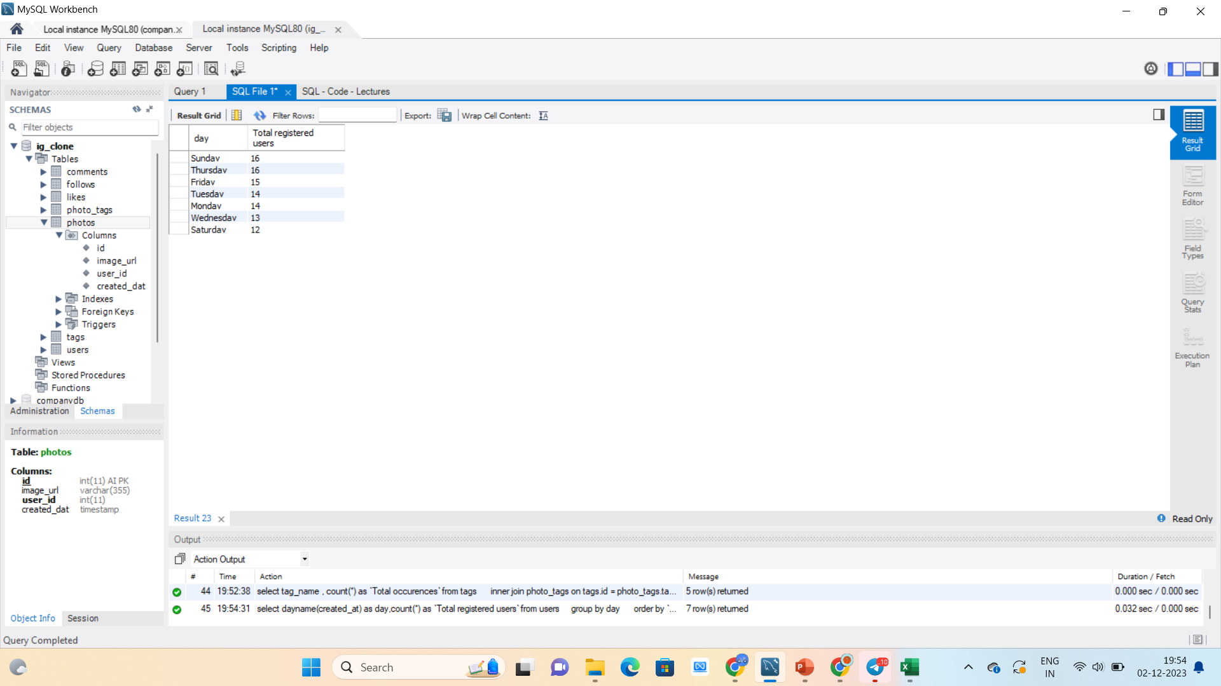
MARKETING ANALYSIS INSIGHTS
5. Ad Campaign Launch
The following table shows the count of users Registered on each day and from this it can be Derived that best days for Launching an AD Campaign are Thursday and Sunday.
Syntax
select dayname(created_at) as day,count(*) as `Total registered users` from users
group by day
order by `Total registered users` desc;

Slide 10
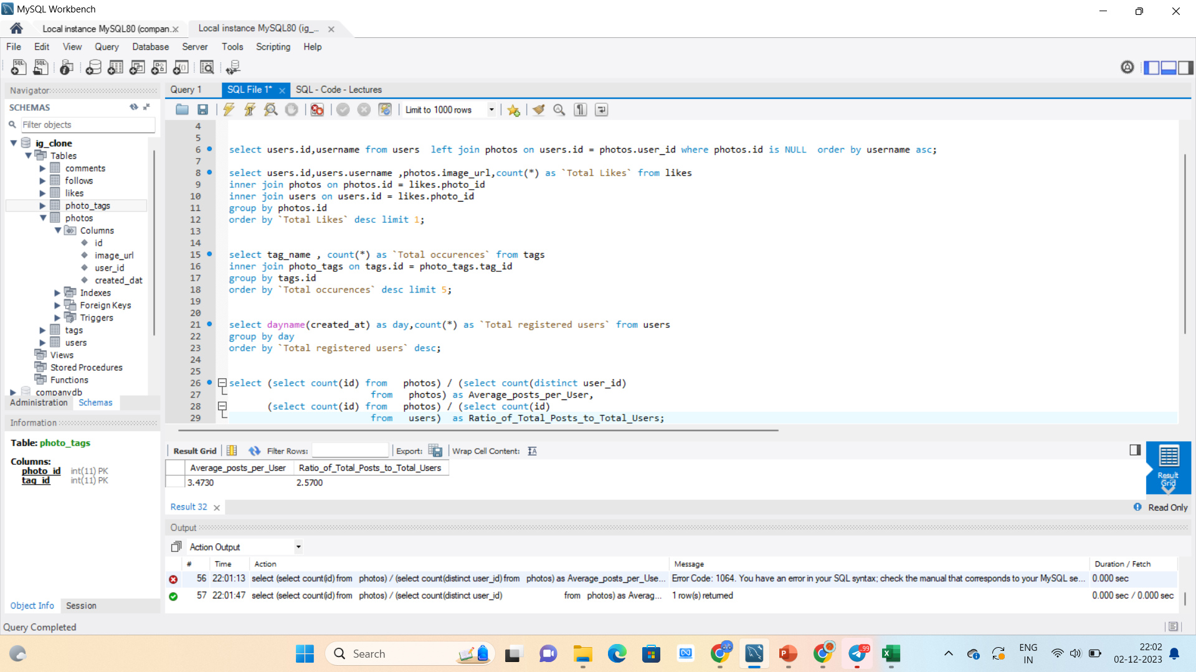
INVESTOR METRICS INSIGHTS
1. User Engagement
The following are the most used tags which can be used by the Partner brand to increase their reach
Syntax
select (select count(id) from photos) / (select count(distinct user_id)
from photos) as Average_posts_per_User,
(select count(id) from photos) / (select count(id)
from users) as Ratio_of_Total_Posts_to_Total_Users;

Slide 11
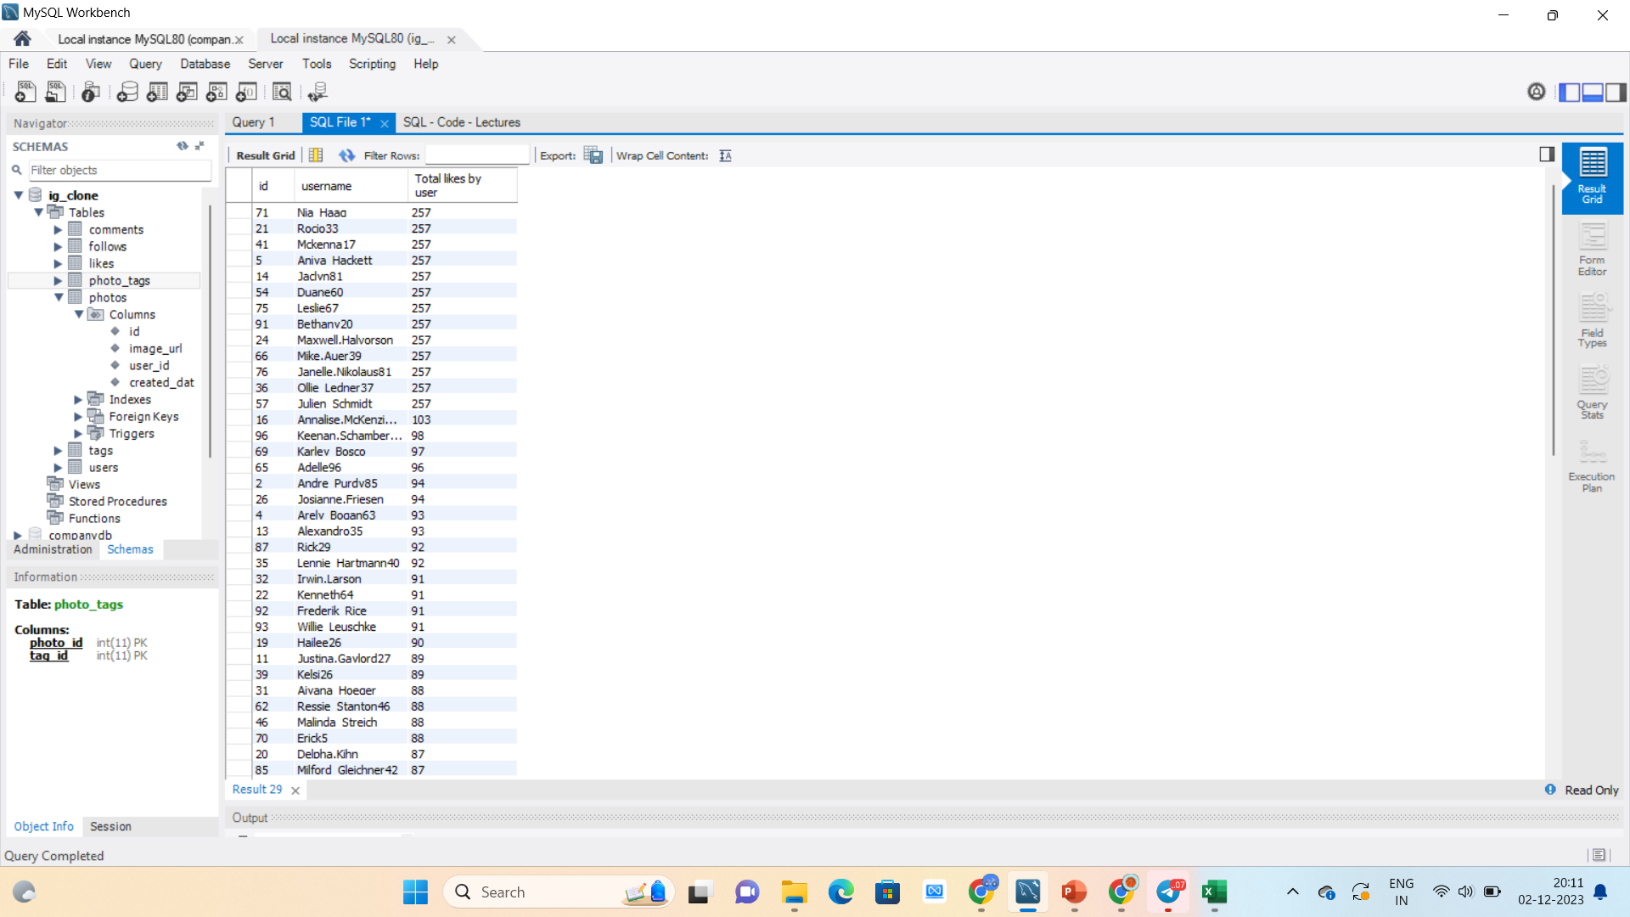
INVESTOR METRICS INSIGHTS
1. Bots & Fake Accounts
Bots are identified by finding those Accounts which has liked every single Photo, shown in the table These accounts are 13 of the total Accounts and all these accounts are those Accounts who have not posted a single Photo.
Syntax
select users.id,users.username,count(*) as `Total likes by user` from users
inner join likes on likes.user_id = users.id
group by likes.user_id
order by `Total likes by user` desc;

Slide 12
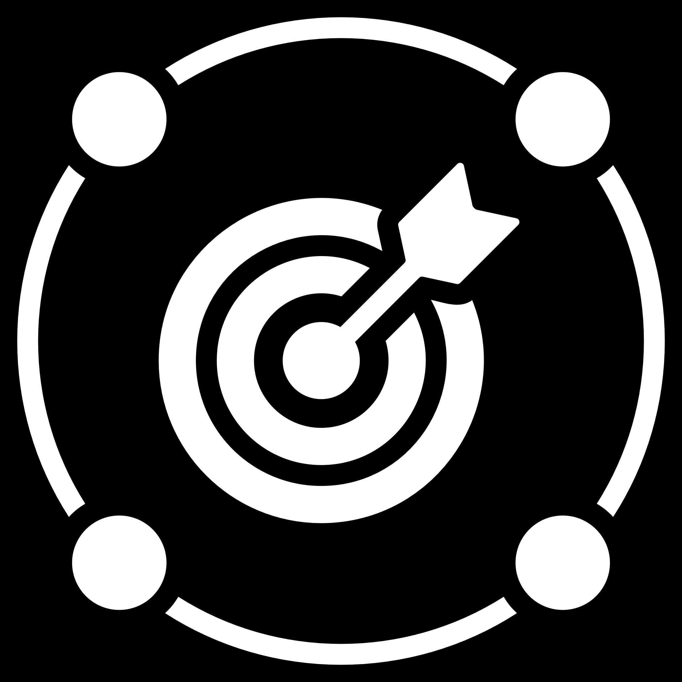
RESULTS
Through the project, meaningful insights were derived to aid decision-making for the Instagram app.
The analysis provided a comprehensive understanding of user behavior, engagement patterns, and potential areas for improvement.
The results are presented in a clear and actionable format, empowering the product team and investors with valuable information.

Slide 13

trainity
THANK YOU

